Slide 1
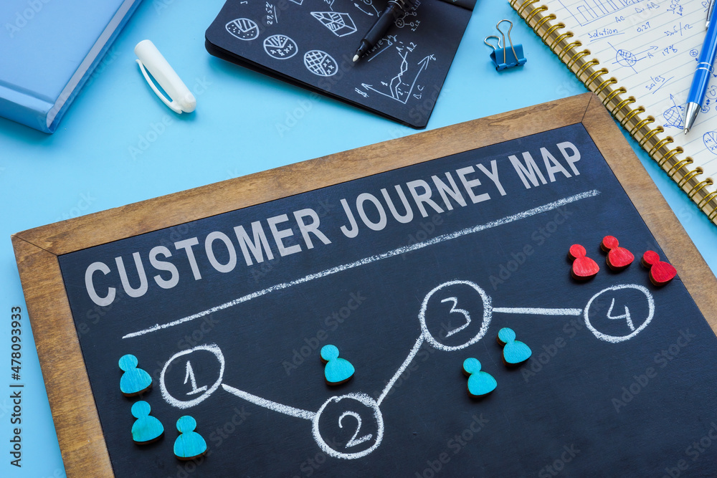
CUSTOMER JOURNEY USING ARTIFICIAL INTELLIGENCE
A Presentation by Priyanka M Patil
KEONICS HUBLI
Guided by Prof. Tahir Mirji .

Slide 2
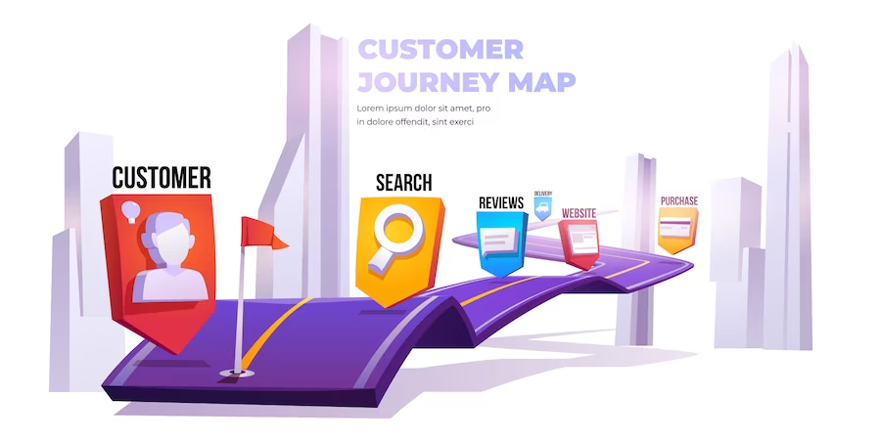
INTRODUCTION
The customer journey is the process that a customer goes through when interacting with a business, from the initial contact to the final purchase and beyond. AI can be used at various stages of the customer journey to enhance the overall experience and improve business outcomes. Here's an example of a customer journey using AI:

Slide 3
AWARENESS:
AI-powered digital advertising: AI algorithms analyze customer data to identify target audiences and deliver personalized ads across various platforms.
Chatbots and virtual assistants: AI-powered chatbots engage with potential customers on the company's website or social media channels, providing quick and automated responses to inquiries.

Slide 4
CONSIDERATION:
Personalized recommendations: AI algorithms analyze customer behavior and preferences to provide tailored product or service recommendations, either through targeted emails or on-site suggestions.
Virtual try-on or customization: AI technology allows customers to virtually try on products, such as clothing or home decor, using augmented reality or 3D visualization tools.
Chatbots for customer support: AI-powered chatbots assist customers with product information, answer frequently asked questions, and provide support during the consideration phase.

Slide 5
PURCHASE:
AI-powered sales assistance: Sales teams can leverage AI to analyze customer data and predict potential leads or upsell opportunities, allowing them to personalize their sales approach.AI-driven pricing optimization: AI algorithms analyze market trends, competitor pricing, and customer behavior to optimize pricing strategies and offer personalized discounts or promotions.
POST-PURCHASE:
AI-powered customer service: Chatbots and virtual assistants continue to provide support post-purchase, assisting with order tracking, returns, or addressing any other customer concerns.
AI-driven sentiment analysis: AI algorithms monitor social media and review platforms to analyze customer sentiment, helping businesses identify and address any issues promptly.
Personalized follow-ups: AI-powered email marketing tools can send personalized follow-up emails based on customer behavior and purchase history, fostering customer loyalty and encouraging repeat purchases.

Slide 6
ADVOCACY:
AI-powered referral programs: AI algorithms can identify satisfied customers and prompt them to refer friends or family members, incentivizing advocacy and word-of-mouth marketing.
AI-driven customer feedback analysis: AI techniques such as natural language processing can analyze customer feedback and reviews, providing valuable insights to improve products or services.
Throughout the customer journey, AI technologies continuously learn and improve based on customer interactions, allowing businesses to deliver more personalized and relevant experiences. However, it's important to strike a balance between automation and human touch, ensuring that customers still have the option to interact with human representatives when needed.

Slide 7
CONCLUSION:
incorporating AI into the customer journey offers numerous benefits for businesses and customers alike. AI can enhance customer experiences by providing personalized recommendations, instant support through chatbots, optimized pricing, and proactive post-purchase engagement.
It enables businesses to better understand customer preferences, predict behavior, and tailor their offerings accordingly. Additionally, AI-powered analytics and feedback systems allow businesses to continuously improve their products and services based on real-time customer insights.
However, it's crucial to strike the right balance between AI automation and human touchpoints. While AI can streamline processes and improve efficiency, human interactions still play a vital role in building trust, empathy, and addressing complex customer needs. A combination of AI and human involvement ensures a seamless and personalized customer journey.
As technology continues to evolve, businesses that effectively leverage AI in the customer journey will gain a competitive edge, foster customer loyalty, and drive growth. By harnessing the power of AI, businesses can create valuable and memorable experiences for their customers throughout the entire customer journey.

Slide 8
THANK YOU

